Slide 1



FOCUSFLOW
Different, Not Less
TEAM
AcademicComebackFr

Slide 2
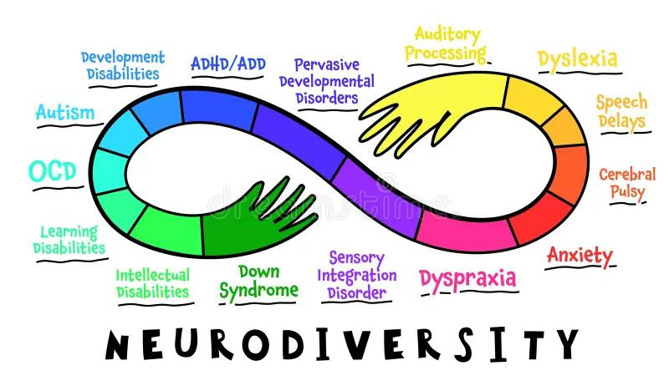

PROBLEM STATEMENT
Neurodiverse students, including those with autism, ADHD, and dyslexia, often struggle in traditional educational settings due to a lack of personalized support. Standardized teaching methods can lead to disengagement and hinder academic success, exacerbating educational inequities.
To address this, there is a need for an AI-driven adaptive learning platform that tailors educational content to the unique needs of each neurodiverse student. By providing personalized lessons and real-time feedback, this platform aims to enhance academic outcomes, improve engagement, and support the overall well-being of neurodiverse learners.

Slide 3
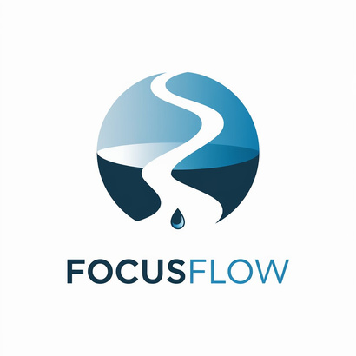
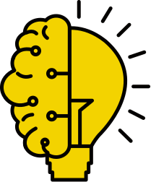


PROPOSED SOLUTION
Attention monitoring system to prevent distraction of students while studying online especially ADHD Students.
A chatbot which uses a LLM which uses a RAG based approach to answer questions and help students who have neurodiverse conditions study better.
We also propose a LLM based chatbot which helps students in social interaction, acting like there own classmates.
We have a pomodoro Timer which helps students use their custom audio track for more relaxing sounds according to the user's needs, and do focused work.
Another one of our features include a TO-DO list which enables user to Create a to-do list. enhance this

Slide 4
REQUIREMENTS AND SCOPE OF THE PLATFORM
Reduces Distraction
Customised Focus Timer
Real-Time Feedback
Content Accessibility
Engagement Monitoring
TO-DO List

Slide 5

OUR MOTIVATION
The motivation behind developing an AI-driven adaptive learning platform is to bridge this gap and provide a more inclusive, personalized educational experience. By leveraging artificial intelligence, we aim to create a platform that tailors educational content and teaching strategies to each student's individual needs. This approach not only enhances engagement and understanding but also promotes a sense of achievement and well-being among neurodiverse learners.

Slide 6

EXISTING SOLUTIONS
Existing solutions for neurodiverse individuals often focus on singular aspects like task management, timers, or basic reminders. Your web application stands out by integrating multiple features specifically tailored to enhance focus and task management. The Attention Monitoring feature, which alerts users when they deviate from a central visual focus, is particularly unique. Coupled with a customizable Pomodoro timer with music and a task ticker, your solution offers a more holistic approach to maintaining productivity and focus, addressing multiple sensory and cognitive needs simultaneously.

Slide 7
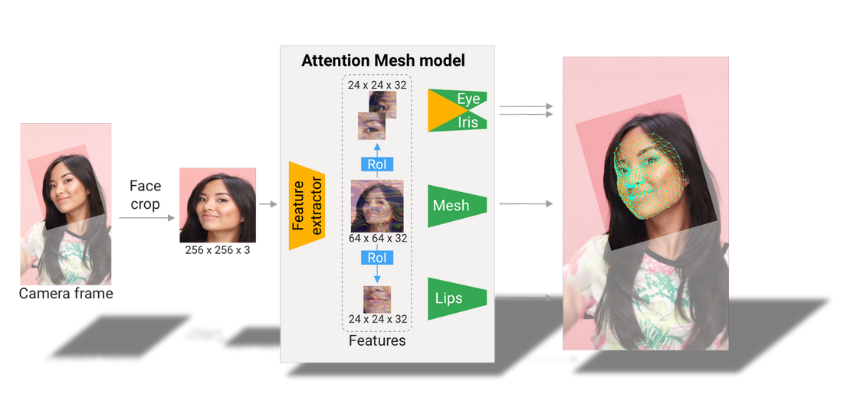
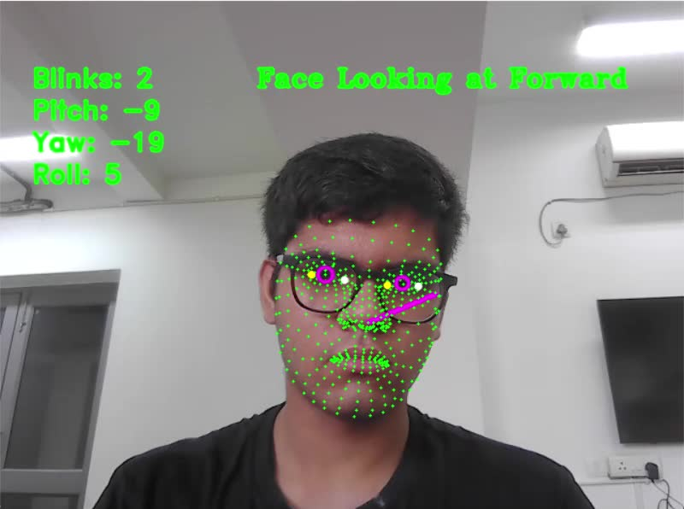
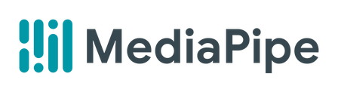
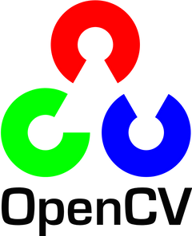
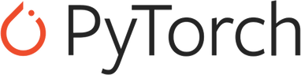
Attention Monitoring Video

Slide 8
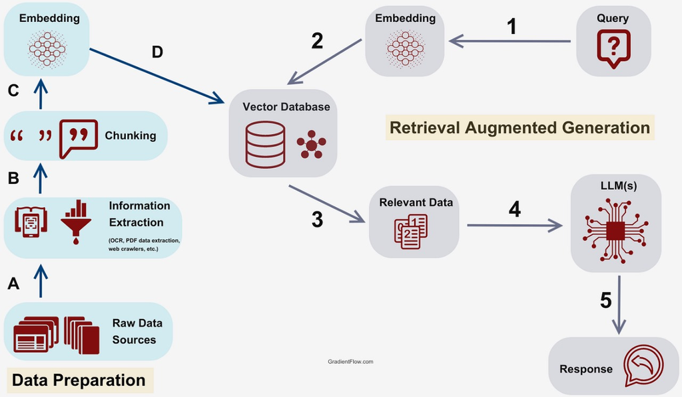
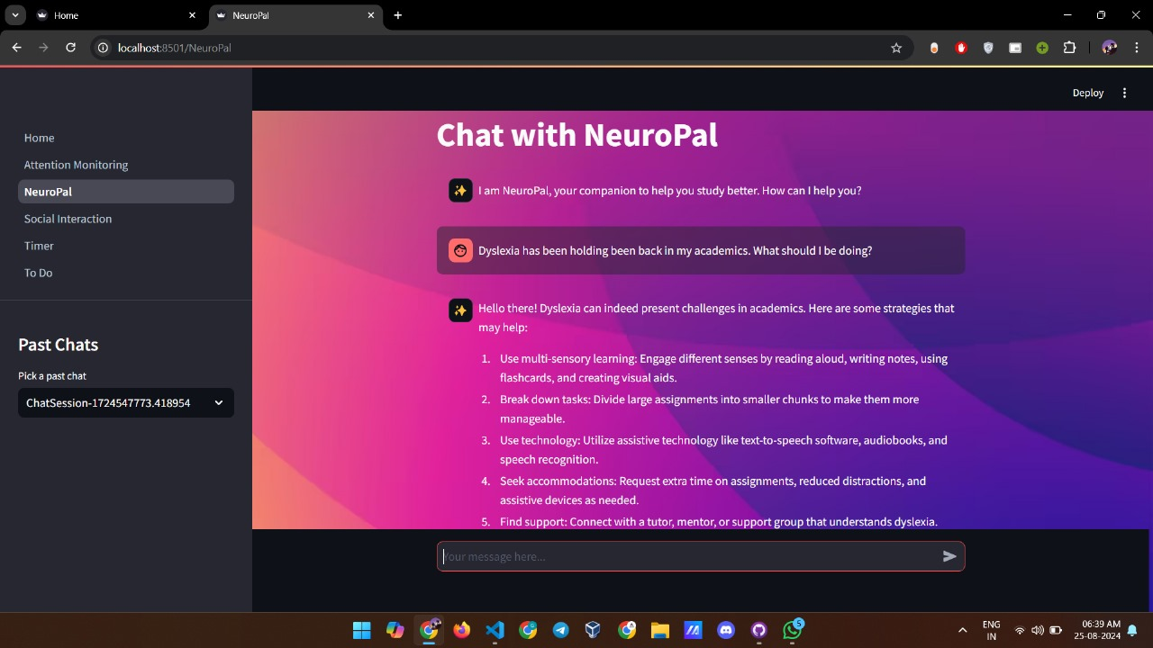
RAG BASED CHATBOTS
Chatbot1 - Based on a text corpus gathered by extensive research.
Chatbot2 - For imitating real life human to human social interaction.

Slide 9
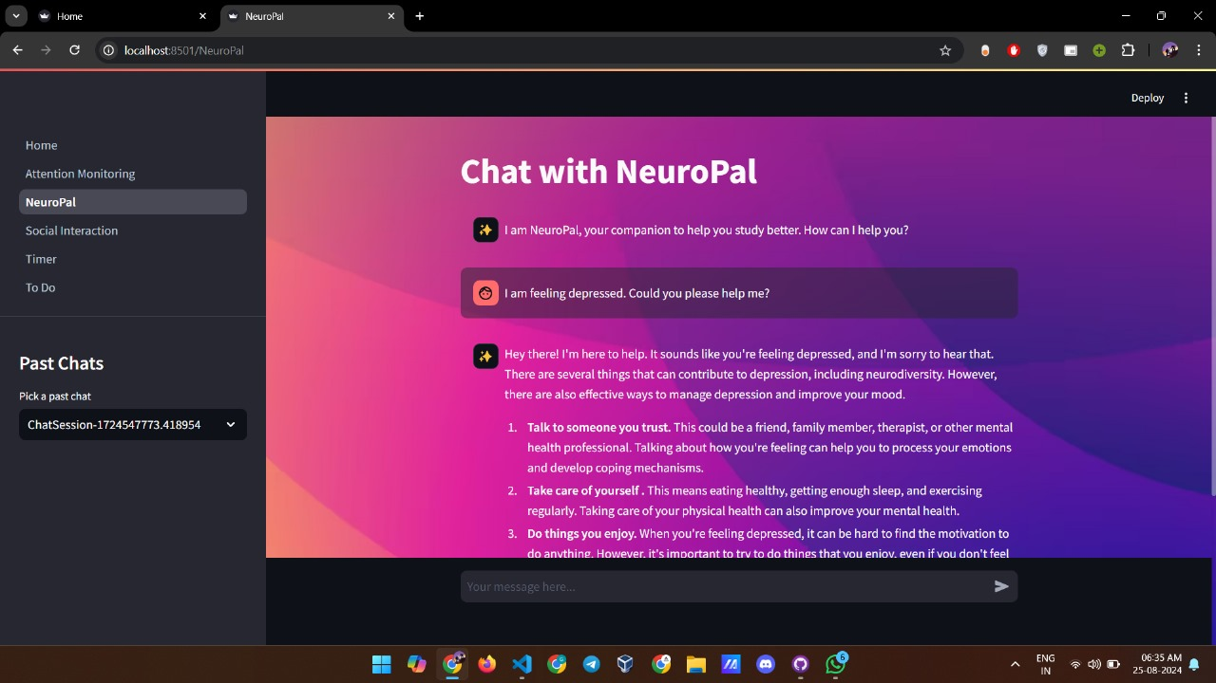
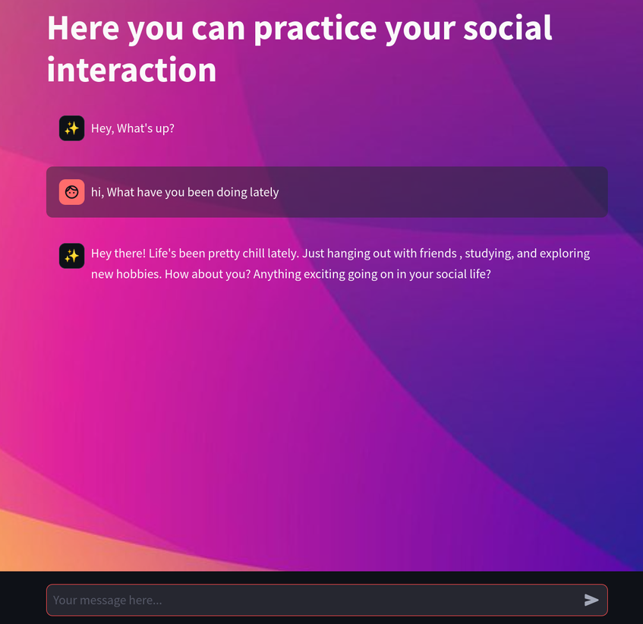

Slide 10
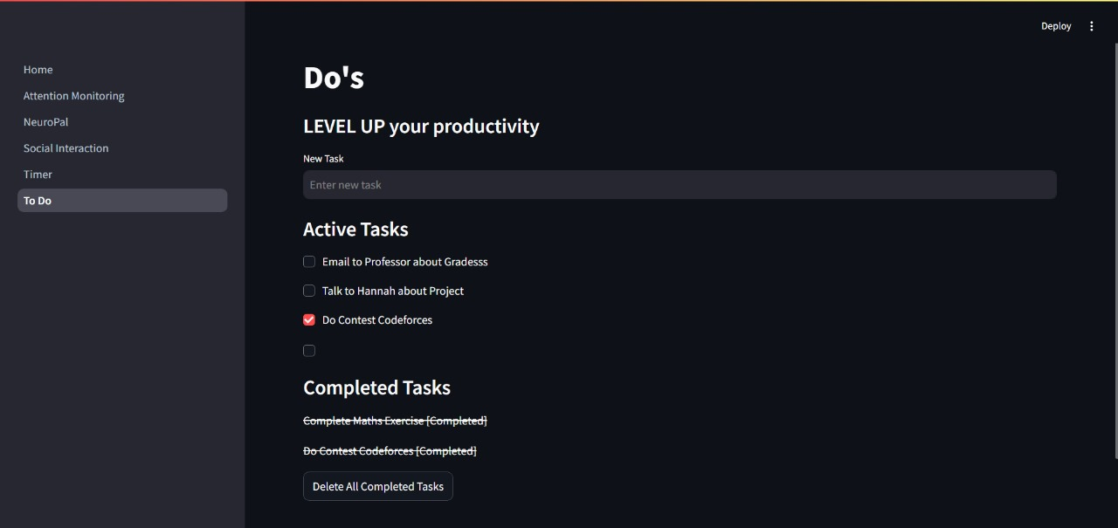
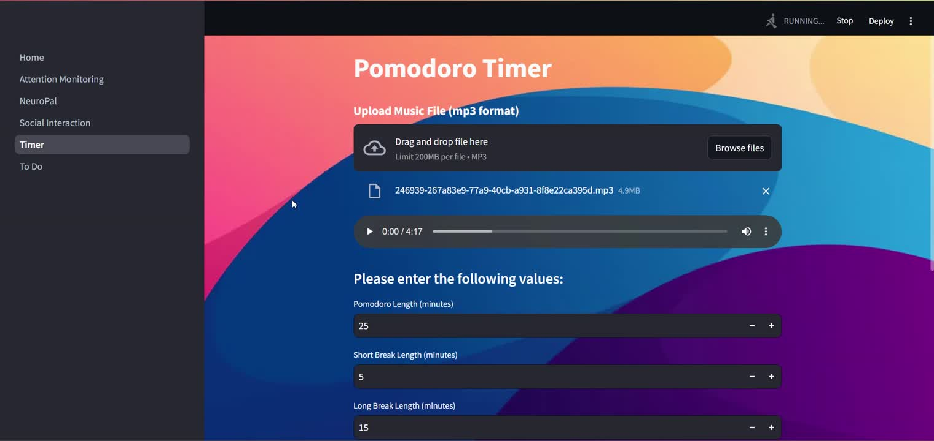
Task Ticker Focus Clock

Slide 11
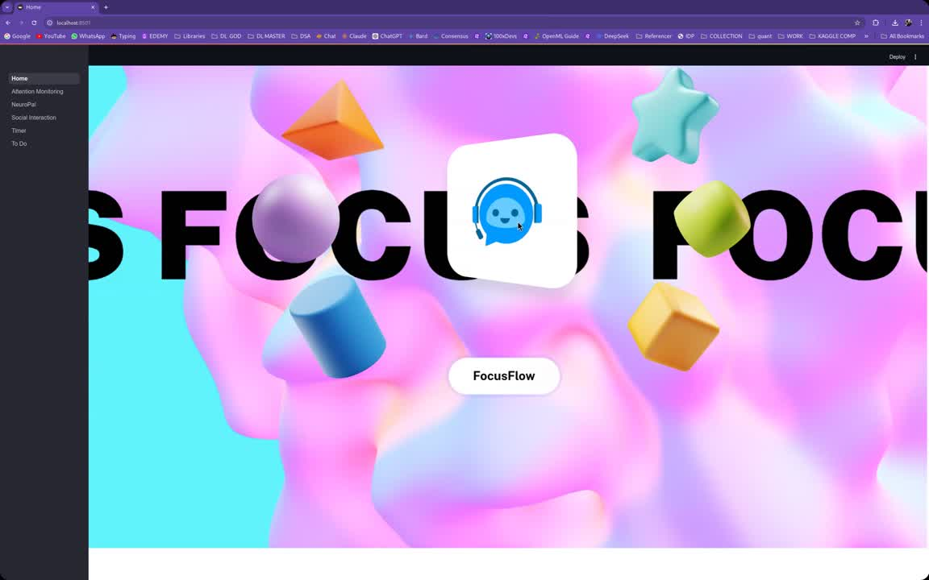

Slide 12
Thank
you!
Efforts by:-
Arnesh Batra(arnesh23129@iiitd.ac.in)
Anushk Kumar(anushk23115@iiitd.ac.in)
Govind Kumar(govind23224@iiitd.ac.in)
Krish Marwah(krish23288@iiitd.ac.in)

